Slide 1

DESIGN AND ANALYSIS OF ALGORITHMS
Course code : CSB-252
Name : PRASUN VERMA
Roll No. : 181210036
Branch : CSE ( 2nd Year )

Slide 2
Contents
Divide and Conquer 3
Backtracking 11
Greedy Method 20
Dynamic Programming 27
Branch and Bound 37
Title Slide No.
Each section has :-
Introduction
Problem Statement
Solution Approach
Code

Slide 3

Divide and conquer

Slide 4
INTRODUCTION
What is it?
A Strategy to solve large problems by :-
1. Breaking the problem into smaller sub-problems
2. Solving the sub-problems, and
3. Combining them to get the desired output.
D&C algorithms are mainly solved with the help of recursions.

Slide 5
INTRODUCTION
How does the algorithms work?
Divide : Divide the given problem into sub-problems using recursion.
Conquer : Solve the smaller sub-problems recursively. If the subproblem is small enough, solve it directly.
Combine : Combine the solutions of the sub problems which is part of the recursive process to achieve the solution.
Examples : Merge Sort, Binary Search ,Quick Sort ,etc.

Slide 6
Problem Statement
Maximum Subarray Sum using Divide and Conquer algorithm
Given a one dimensional array that may contain both positive and negative integers, find the sum of contiguous subarray of numbers which has the largest sum.
For example, if the given array is {-2, -5, 6, -2, -3, 1, 5, -6}, then the maximum subarray sum is 7 .

Slide 7
SOLUTION APPROACH
Naïve method
Run two loops
the outer loop selects the beginning element and find the maximum possible sum with first element picked by outer loop, and
compares this maximum with the overall maximum value.
The time complexity of this approach is O( n² ).

Slide 8
SOLUTION APPROACH
How can we perform better ?
USING DIVIDE & CONQUER ALGORITHM :-
Divide the array into two equal subarrays.
Recursively calculate the maximum subarray sum for left subarray.
Recursively calculate the maximum subarray sum for right subarray.
Find the maximum subarray sum that crosses mid element.
Return the maximum of above three sums.
The time complexity of this approach is O( n log(n) )

Slide 9
CODE
// Utility function to find maximum of two numbers
int max(int x, int y) {
return (x > y) ? x : y;
}
// Function to find maximum subarray sum using divide and conquer
int maximum_sum(int A[], int low, int high)
{
// If array contains only one element
if (high == low)
return A[low];
// Find middle element of the array
int mid = (low + high) / 2;
// Find maximum subarray sum for the left subarray
// including the middle element
int left_max = INT_MIN;
int sum = 0;
for (int i = mid; i >= low; i--)
{
sum += A[i];
if (sum > left_max)
left_max = sum;
}

Slide 10
CODE
// Find maximum subarray sum for the right subarray
// excluding the middle element
int right_max = INT_MIN;
sum = 0; // reset sum to 0
for (int i = mid + 1; i <= high; i++)
{
sum += A[i];
if (sum > right_max)
right_max = sum;
}
// Recursively find the maximum subarray sum for left subarray
// and right subarray and take maximum
int max_left_right = max(maximum_sum(A, low, mid),
maximum_sum(A, mid + 1, high));
// return maximum of the three
return max(max_left_right, left_max + right_max);
}
// Maximum Sum Subarray using Divide & Conquer
int main(void)
{
int arr[] = { 2, -4, 1, 9, -6, 7, -3 };
int n = sizeof(arr) / sizeof(arr[0]);
cout<<"The maximum sum of the subarray is”<<maximum_sum(arr, 0, n - 1);
return 0;
}

Slide 11

BACKTRACKING

Slide 12
INTRODUCTION
What is it?
It is a problem solving algorithm which uses a brute force approach for finding the desired output.
In backtracking, if the current solution is not suitable, then we backtrack and try other solutions.
Recursion is used here too.
This approach is used to solve problems that have multiple solutions.
Brute force approach tries out all the possible solutions and chooses the desired/best solutions.

Slide 13
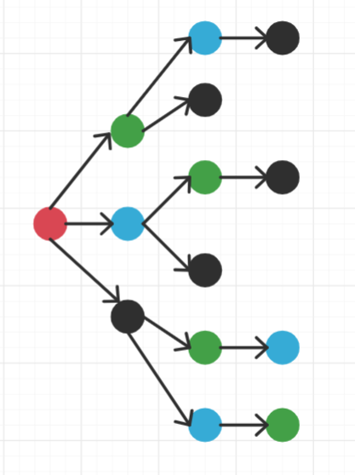
INTRODUCTION
Legend
Start
Girl
Boy 1
Boy 2
How does it work?
Real World Example : To find all the possible ways of arranging 2 boys and 1 girl on 3 benches. Constraint: Girl should not be on the middle bench.
There are a total of 3! = 6 possibilities.
We try all the possibilities and get the possible
solutions. We recursively try all the possibilities.
✓
✗
✓
Possibilities are :-
✗
✓
✓

Slide 14
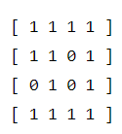
Problem Statement
Find the total number of unique paths which the robot can take in a given maze to reach the destination from given source.
Positions in the maze will either be open or blocked with an obstacle. The Robot can only move to positions without obstacles, i.e. solution should find paths which contain only cells which are open.
Retracing the 1 or more cells back and forth is not considered a new path. The set of all cells covered in a single path should be unique from other paths.
At any given moment, the robot can move only 1 step in one of 4 directions.
Eg. 4x4 Maze
0 : blocked cell
1 : open cell

Slide 15
SOLUTION APPROACH
Valid Moves are :-
Move North : (x,y) -> (x-1,y)
Move East : (x,y) -> (x,y+1)
Move West : (x,y) -> (x,y-1)
Move South : (x,y) -> (x+1,y)
The Robot search for a path from the starting position to the goal position until it finds one or until it exhausts all possibilities.
We achieve this using Backtracking technique.

Slide 16
SOLUTION APPROACH
Start from given source cell in the matrix and explore all four paths possible and recursively check if they will lead to the destination or not.
Update the unique path count whenever destination cell is reached. If path doesn’t reach destination or we’ve explored all possible routes from the current cell, we backtrack.
To make sure that the path is simple and doesn’t contain any cycle, we keep track of cells involved in current path in a matrix before exploring any cell, we ignore the cell if it is already covered in current path.

Slide 17
CODE
/* This is backtracking based problem
An extension of Rat in a Maze problem
The robot can move in all 4 directions, North,East,South and West
Robot can move only into the open cells
*/
#define N 4 // Defines the size of the Maze, N x N maze
// checks if cell (x, y) is valid or not
bool isValidCell(int x, int y)
{
if (x < 0 || y < 0 || x >= N || y >= N)
return false;
return true;
}
void countPaths(int maze[N][N], int x, int y, int visited[N][N], int& count)
{
// if destination (bottom-rightmost cell) is found,increment the path count
if (x == N - 1 && y == N - 1)
{
count++;
return;
}
// mark current cell as visited
visited[x][y] = 1;

Slide 18
CODE
// if current cell is a valid and open cell,
if (isValidCell(x, y) && maze[x][y])
{
if (x + 1 < N && !visited[x + 1][y]) // move down (x, y) --> (x + 1, y)
countPaths(maze, x + 1, y, visited, count);
if (x - 1 >= 0 && !visited[x - 1][y]) // move up (x, y) --> (x - 1, y)
countPaths(maze, x - 1, y, visited, count);
if (y + 1 < N && !visited[x][y + 1]) // move right (x, y) --> (x, y + 1)
countPaths(maze, x, y + 1, visited, count);
if (y - 1 >= 0 && !visited[x][y - 1]) // move left (x, y) --> (x, y - 1)
countPaths(maze, x, y - 1, visited, count);
}
visited[x][y] = 0; // backtrack from current cell and remove it from current path
}
int main()
{
int maze[N][N] =
{
{ 1, 1, 1, 1 },
{ 1, 1, 0, 1 },
{ 0, 1, 0, 1 },
{ 1, 1, 1, 1 }
};

Slide 19
CODE
int count = 0; // variable to keep track of number of unique paths from source to destination
int visited[N][N]; // 2D matrix to keep track of cells involved in current path
memset(visited, 0, sizeof visited);
// start from source cell (0,0)
countPaths(maze, 0, 0, visited, count);
cout << "Total number of unique paths are " << count;
return 0;
}
}

Slide 20
GREEDY METHOD

Slide 21
INTRODUCTION
What is it?
An approach for solving a problem by selecting the best option available at the moment, without worrying about the future result it would bring.
Never goes back to reverse the decision made. This algorithm works in a top-down approach.
The main advantage of this algorithm is:
The algorithm is easier to describe.
This algorithm can perform better than other algorithms (but, not in all cases).
Example - To make a change of an amount using the smallest possible number of coins.
Amount: Rs 18 Available coins: Rs 5, Rs 2, Rs 1 coins

Slide 22
INTRODUCTION
How does it work?
Greedy Algorithm
To begin with, the solution set (containing answers) is empty.
At each step, an item is added into the solution set.
If the solution set is feasible, the current item is kept.
Else, the item is rejected and never considered again.

Slide 23
Problem Statement
EGYPTIAN FRACTION
An Egyptian fraction is the sum of finitely many rational numbers, each of which can be expressed in the form 1/q​, where q is a positive integer.
Every positive fraction can be represented as sum of unique unit fractions. A fraction is unit fraction if numerator is 1 and denominator is a positive integer, for example 1/3 is a unit fraction. Such a representation is called Egyptian Fraction as it was used by ancient Egyptians.
For example : the Egyptian fraction 61/66​ can be written as
61/66 =1/2 + 1/3 + 1/11.

Slide 24
SOLUTION APPROACH
For a given number of the form p/q ,where p<q
Extract the largest unit fraction : 1/ceil(q/p)
Subtract that unit fraction from the original fraction
Recursively follow the same procedure for the remainders
At last we would be left with a set of Egyptian Fractions

Slide 25
CODE
/* Egyptian Fraction problem
Using Greedy Algorithm */
#include <iostream>
using namespace std;
void EgyptianFrac(int , int );
int main()
{
int num,den; // num stands for numerator part and den for denominator part
cout<<"Enter numerator and denominator respectively of the form (n/m) : ";
cin>>num>>den;
cout << "Egyptian Fraction Representation of "<< num << "/" << den << " is\n = ";
EgyptianFrac(num, den);
return 0;
}
void EgyptianFrac(int n,int d)
{
// If either numerator or denominator is 0
if (d == 0 || n == 0)
return;
// If numerator divides denominator, then simple division
// makes the fraction in 1/n form
if (d%n == 0)
{
cout << "1/" << d/n;
return;
}

Slide 26
CODE
if (n%d == 0)// If denominator divides numerator, then the given number is not fraction
{
cout << n/d;
return;
}
if (n > d) // numerator is greater than denominator
{
cout << n/d << " + ";
EgyptianFrac(n%d, d);
return;
}
// We reach here dr > nr and dr%nr is non-zero
// Find ceiling of dr/nr and print it as first fraction
int c = d/n + 1;
cout << "1/" << c << " + ";
EgyptianFrac(n*c-d, d*c); // Recursion for the rest part
}

Slide 27

Slide Title
Dynamic programming

Slide 28
INTRODUCTION
What is it?
A technique that helps to efficiently solve a class of problems that have overlapping subproblems and optimal substructure property.
Dynamic programming is optimization over plain recursion.
The idea is to simply store the results of subproblems, so that we do not have to re-compute them when needed later.
This simple optimization reduces time complexities from exponential to polynomial.
Memoization : optimization technique used to speed up programs by storing the results of expensive function calls and returning the cached result when the same inputs occur again.
Tabulation : an approach where a problem is solved by first filling up a table, and then compute the solution to the original problem based on the results in this table.

Slide 29
INTRODUCTION
How does it work?
Dynamic programming works by storing the result of subproblems so that when their solutions are required, they are at hand and we do not need to recalculate them.
This technique of storing the value of subproblems is called memoization. By saving the values in the array, we save time for computations of sub-problems we have already come across.
Reversing the direction in which the algorithm works i.e. starting from the base case and working towards the solution, we can also implement dynamic programming in a bottom-up manner.

Slide 30
Problem Statement
Rod Cutting Problem
Given a rod of length n and list of prices of rod of length i, where 1<=i<=n, find the optimal way to cut rod into smaller rods in order to maximize profit.

Slide 31
SOLUTION APPROACH
Suppose we’ve the following Rod Cutting Length-Rates Table :-
We have to Cut a Rod of Length = 4
Length | 1 | 2 | 3 | 4 | 5 | 6 | 7 | 8
Rates | 2 | 6 | 9 | 10 | 11 | 18 | 18 | 21

Slide 32
SOLUTION APPROACH
Naïve method
A naive solution for this problem is to generate all configurations of different pieces and find the highest priced configuration.
This solution is exponential in term of time complexity O(n^{n} ).
Cut | Profit
4 | 10
1,3 | 2+9=11
2,2 | 6+6=12
3,1 | 9+2=11
1,1,2 | 2+2+6=10
1,2,1 | 2+6+2=10
2,1,1 | 6+2+2=10
1,1,1,1 | 2+2+2+2=8
This one has the maximum profit

Slide 33
SOLUTION APPROACH
How can we perform better ?
USING DYNAMIC PROGRAMMING
1.Optimal Substructure : To achieve best price by making a cut at different positions and comparing the values obtained after a cut.
Recursively call the same function for a piece obtained after a cut.
Let Rodcut(n) be the required (best possible price) value for a rod of length ‘n’, Rodcut(n) can be written as following :-
Rodcut(n) = max(price[i-1] + Rodcut(n-i) ) ,where 1<=i <=n
2)Overlapping Subproblems The implementation simply follows the recursive structure mentioned above.

Slide 34
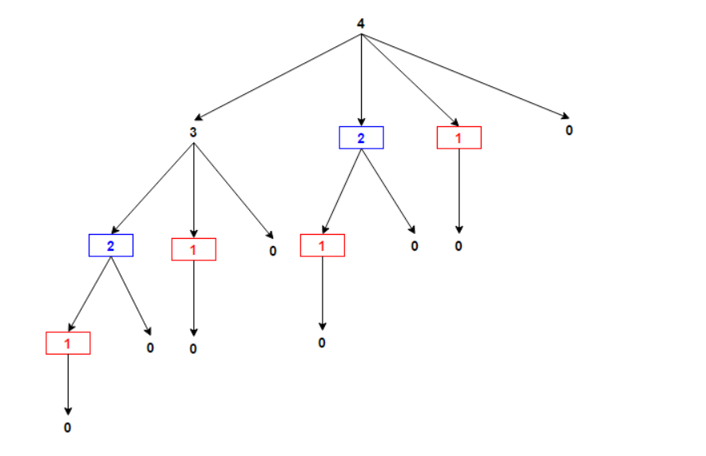
SOLUTION APPROACH
Overlapping Subproblems

Slide 35
SOLUTION APPROACH
How can we perform better ?
In above figure, same sub-problems have same colour, they’re getting computed again & again.
We solve this using memoization, in which subproblem solutions are saved rather than computing again.
Solving it in bottom-up approach, smaller sub-problems are solved first, then larger sub-problems are solved from them.
T[i] stores maximum profit achieved from rod of length of ‘i’,
for each 1<=i <=n. It uses value of smaller values ‘i’ already
computed.

Slide 36
CODE
/*
Rod Cutting Maximization problem
using Dynamic Programming
*/
#include <iostream>
#include <string>
using namespace std;
int rodCut(int price[], int n) // finds maximum profit
{
int T[n + 1]; // T[i] stores maximum profit achieved from rod of length i
for (int i = 0; i <= n; i++) // initialize maximum profit to 0
T[i] = 0;
for (int i = 1; i <= n; i++) // consider rod of length i
{
for (int j = 1; j <= i; j++) // divide the length i into two rods of length j & i-j each and take maximum
T[i] = max(T[i], price[j - 1] + T[i - j]);
}
return T[n]; // T[n] stores maximum profit achieved from rod of length n
}
int main()
{
int price [] = { 2, 6, 9, 10, 11, 18, 18, 21 }; // prices for length 1 to n,here n=8
int rodlength = 6; // rod length
cout << "Profit is " << rodCut(price, rodlength);
return 0;
}

Slide 37
Branch and bound

Slide 38
INTRODUCTION
What is it?
It is an algorithm generally used for solving combinatorial optimization problems and only minimization problems.
These problems are typically exponential in terms of time complexity and may require exploring all possible permutations in worst case.
It is similar to backtracking in the sense that it also uses state space tree for solving a problem,
In graph traversals it uses BFS approach instead of DFS.
State space tree is a tree constructed from all of the possible states of the problem as nodes connected via state transitions from some initial state as root to some terminal state as leaf

Slide 39
Problem Statement
0-1 KNAPSACK PROBLEM
Given two integer arrays val[0..n-1] and wt[0..n-1] that represent values and weights associated with n items respectively. Find out the maximum value subset of val[] such that sum of the weights of this subset is smaller than or equal to Knapsack capacity W.

Slide 40
SOLUTION APPROACH
Sort all items in decreasing order of ratio of value per unit weight so that an upper bound can be computed using Greedy Approach.
Initialize maximum profit, maxProfit = 0
Create an empty queue, Q.
Create a dummy node of decision tree and enqueue it to Q. Profit and weight of dummy node are 0.

Slide 41
SOLUTION APPROACH
Do following while Q is not empty.
Extract an item from Q. Let the extracted item be u.
Compute profit of next level node. If the profit is more than maxProfit, then update maxProfit.
Compute bound of next level node. If bound is more than maxProfit, then add next level node to Q.
Consider the case when next level node is not considered as part of solution and add a node to queue with level as next, but weight and profit without considering next level nodes.

Slide 42
CODE
// Structure for Item which store weight and corresponding value of Item
struct Item
{
float weight;
int value;
};
struct Node // Node structure to store information of decision tree
{
int level, profit, bound;
float weight;
};
bool cmp(Item a, Item b) // Comparison function to sort item according value/weight ratio
double r1 = (double)a.value / a.weight;
double r2 = (double)b.value / b.weight;
return r1 > r2;
}
// Returns bound of profit in subtree rooted with u (Greedy approach to find an upper bound on max profit)
int bound(Node u, int n, int W, Item arr[])
{
if (u.weight >= W)
return 0;
int profit_bound = u.profit;
int j = u.level + 1;
int totweight = u.weight;
while ((j < n) && (totweight + arr[j].weight <= W))
}

Slide 43
CODE
{
totweight += arr[j].weight;
profit_bound += arr[j].value;
j++;
}
if (j < n)
profit_bound += (W - totweight) * arr[j].value /
arr[j].weight;
return profit_bound;
}
// Returns maximum profit we can get with capacity W
int knapsack(int W, Item arr[], int n)
{
sort(arr, arr + n, cmp);
queue<Node> Q;
Node u, v;
u.level = -1;
u.profit = u.weight = 0;
Q.push(u);
int maxProfit = 0;
while (!Q.empty())
{
u = Q.front();
Q.pop();
if (u.level == -1)
v.level = 0;

Slide 44
CODE
if (u.level == n-1)
continue;
v.level = u.level + 1;
v.weight = u.weight + arr[v.level].weight;
v.profit = u.profit + arr[v.level].value;
if (v.weight <= W && v.profit > maxProfit)
maxProfit = v.profit;
v.bound = bound(v, n, W, arr);
if (v.bound > maxProfit)
Q.push(v);
v.weight = u.weight;
v.profit = u.profit;
v.bound = bound(v, n, W, arr);
if (v.bound > maxProfit)
Q.push(v);
}
return maxProfit;
int main()
{
int W = 10; // Weight of knapsack
Item arr[] = {{2, 30}, {3.14, 40}, {1.98, 80},
{5, 85}, {3, 40}};
int n = sizeof(arr) / sizeof(arr[0]);
cout << "Maximum possible profit = "
<< knapsack(W, arr, n);
return 0;
}

Slide 45

THANK YOU
FIRST UP CONSULTANTS
For Codes of the problem navigate to below link
https://github.com/nitcse2018/daa-prasium

